Slide 1
Quick Sort

Slide 2
Quicksort
A[p…q]
≤
A[q+1…r]
Sort an array A[p…r]
Divide
Partition the array A into 2 subarrays A[p..q] and A[q+1..r], such that each element of A[p..q] is smaller than or equal to each element in A[q+1..r]
Need to find index q to partition the array

Slide 3
Quicksort
A[p…q]
≤
A[q+1…r]
Conquer
Recursively sort A[p..q] and A[q+1..r] using Quicksort
Combine
Trivial: the arrays are sorted in place
No additional work is required to combine them
The entire array is now sorted

Slide 4
QUICKSORT
Initially: p=1, r=n
Alg.: QUICKSORT(A, p, r)
if p < r
then q ← PARTITION(A, p, r)
QUICKSORT (A, p, q)
QUICKSORT (A, q+1, r)
Recurrence:
T(n) = T(q) + T(n – q) + f(n)
PARTITION())

Slide 5
Partitioning the Array
Choosing PARTITION()
There are different ways to do this
Each has its own advantages/disadvantages
Hoare partition (see prob. 7-1, page 159)
Select a pivot element x around which to partition
Grows two regions
A[p…i] ≤ x
x ≤ A[j…r]
A[p…i] ≤ x
x ≤ A[j…r]
i
j

Slide 6
Example
A[p…r]
pivot x=5
5
3
2
6
4
1
3
7
5
3
2
6
4
1
3
7
i
j
i
j
3
3
2
6
4
1
5
7
3
3
2
6
4
1
5
7
i
j
i
j
A[p…q]
A[q+1…r]
3
3
2
1
4
6
5
7
3
3
2
1
4
6
5
7
i
j
j
i

Slide 7
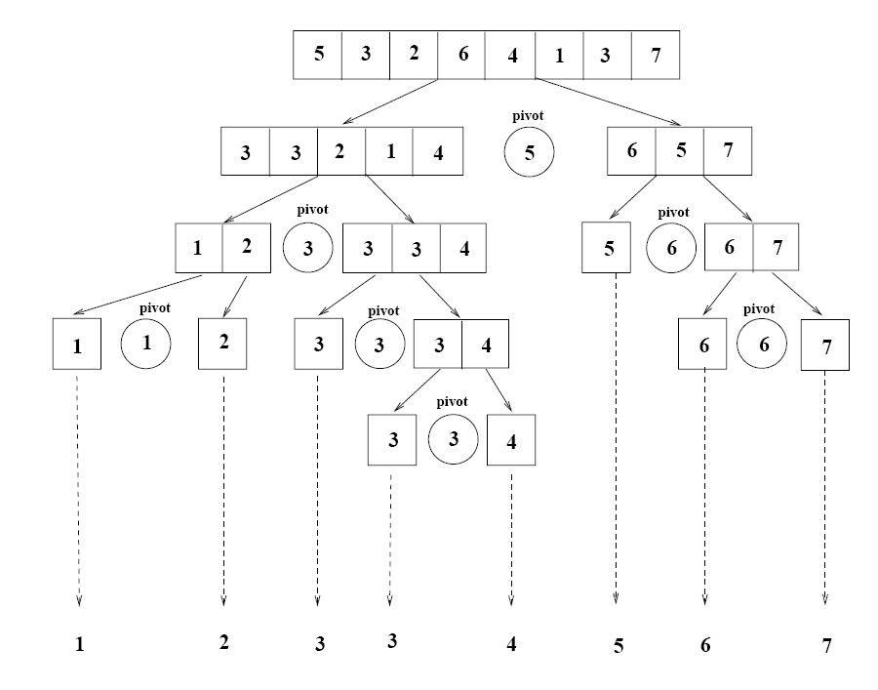
Example

Slide 8
Partitioning the Array
Alg. PARTITION (A, p, r)
x ← A[p]
i ← p – 1
j ← r + 1
while TRUE
do repeat j ← j – 1
until A[j] ≤ x
do repeat i ← i + 1
until A[i] ≥ x
if i < j
then exchange A[i] ↔ A[j]
else return j
p
r
A:
5
3
2
6
4
1
3
7
i
j
A[p…q]
≤
A[q+1…r]
A:
a_{p}
a_{r}
j=q
i
Each element is
visited once!
Running time: Θ(n)
n = r – p + 1

Slide 9
Recurrence
Initially: p=1, r=n
Alg.: QUICKSORT(A, p, r)
if p < r
then q ← PARTITION(A, p, r)
QUICKSORT (A, p, q)
QUICKSORT (A, q+1, r)
Recurrence:
T(n) = T(q) + T(n – q) + n

Slide 10
Worst Case Partitioning
Worst-case partitioning
One region has one element and the other has n – 1 elements
Maximally unbalanced
Recurrence: q=1
T(n) = T(1) + T(n – 1) + n,
T(1) = Θ(1)
T(n) = T(n – 1) + n
=
n
n
1
n - 1
n
1
n - 2
n - 1
n
1
n - 3
n - 2
1
2
3
1
1
2
Θ(n²)
When does the worst case happen?

Slide 11
Best Case Partitioning
Best-case partitioning
Partitioning produces two regions of size n/2
Recurrence: q=n/2
T(n) = 2T(n/2) + Θ(n)
T(n) = Θ(nlgn) (Master theorem)

Slide 12
Case Between Worst and Best
9-to-1 proportional split
Q(n) = Q(9n/10) + Q(n/10) + n

Slide 13
How does partition affect performance?

Slide 14
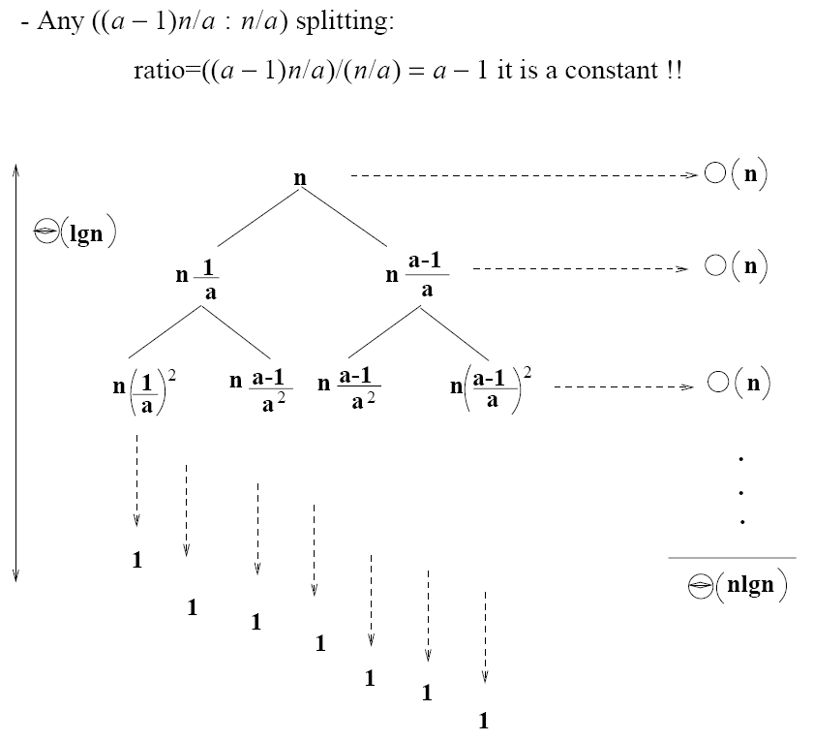
How does partition affect performance?

Slide 15
Performance of Quicksort
Average case
All permutations of the input numbers are equally likely
On a random input array, we will have a mix of well balanced and unbalanced splits
Good and bad splits are randomly distributed across throughout the tree
partitioning cost:
n = Θ(n)
n
combined partitioning cost:
2n-1 = Θ(n)
n
1
n - 1
(n – 1)/2 + 1
(n – 1)/2
(n – 1)/2
(n – 1)/2
Alternate of a good
and a bad split
Nearly well
balanced split
Running time of Quicksort when levels alternate between good and bad splits is O(nlgn)

